Slide 1
Cloud provider services Introduction to AWS Services
Cloud Computing
Prof Rajiv Misra
IIT Patna
13-04-2022

Slide 2
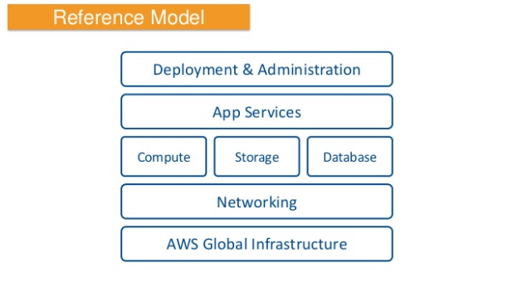
Reference Model

Slide 3
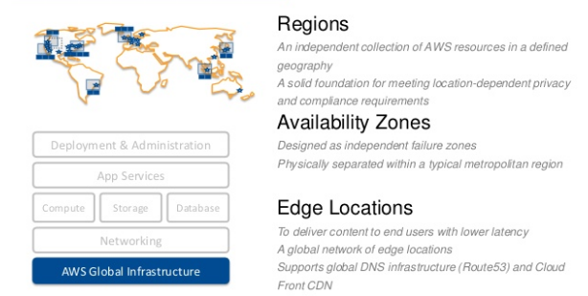
Global Infrastructure

Slide 4
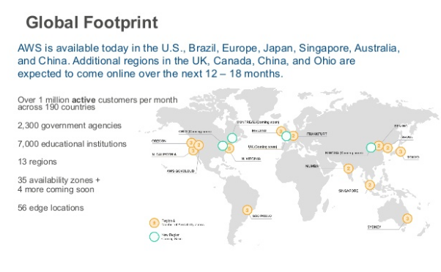
Global Footprint

Slide 5
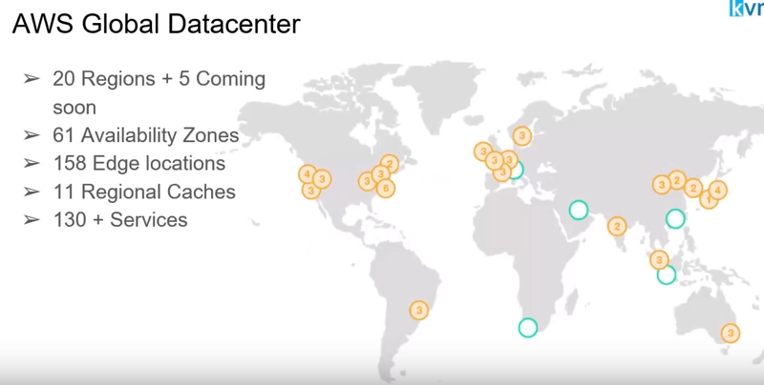

AWS Global Datacenter

Slide 6
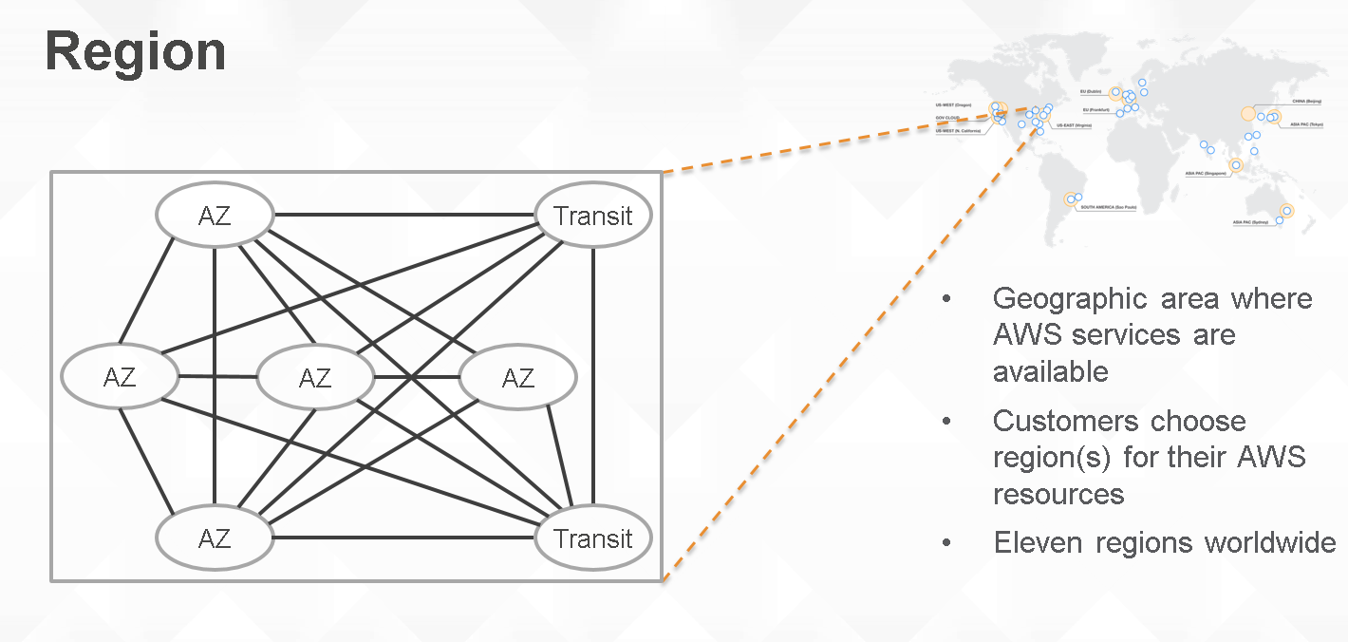

Slide 7
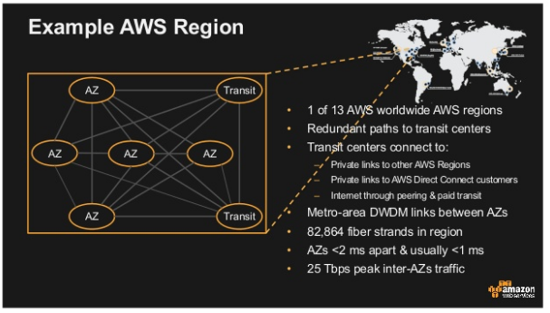

Slide 8
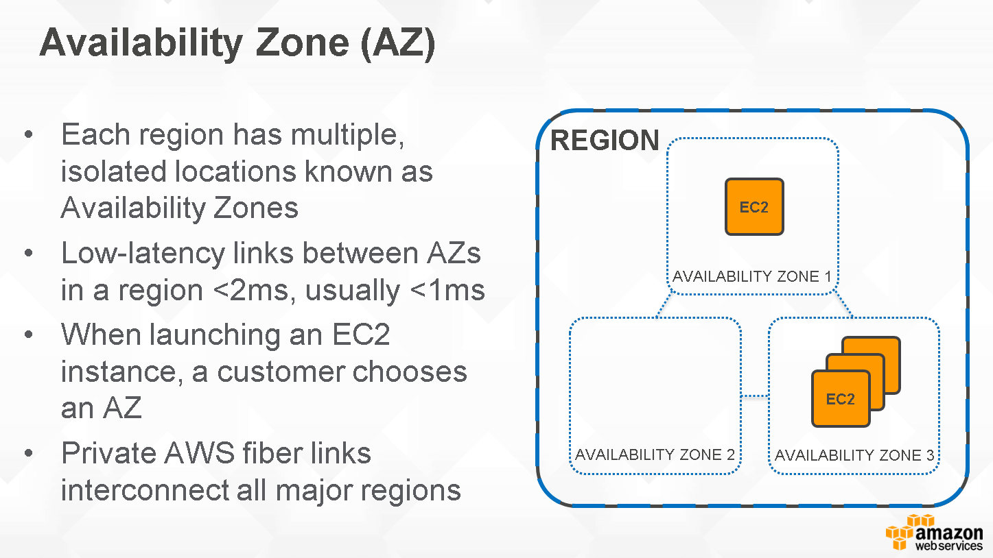

Slide 9
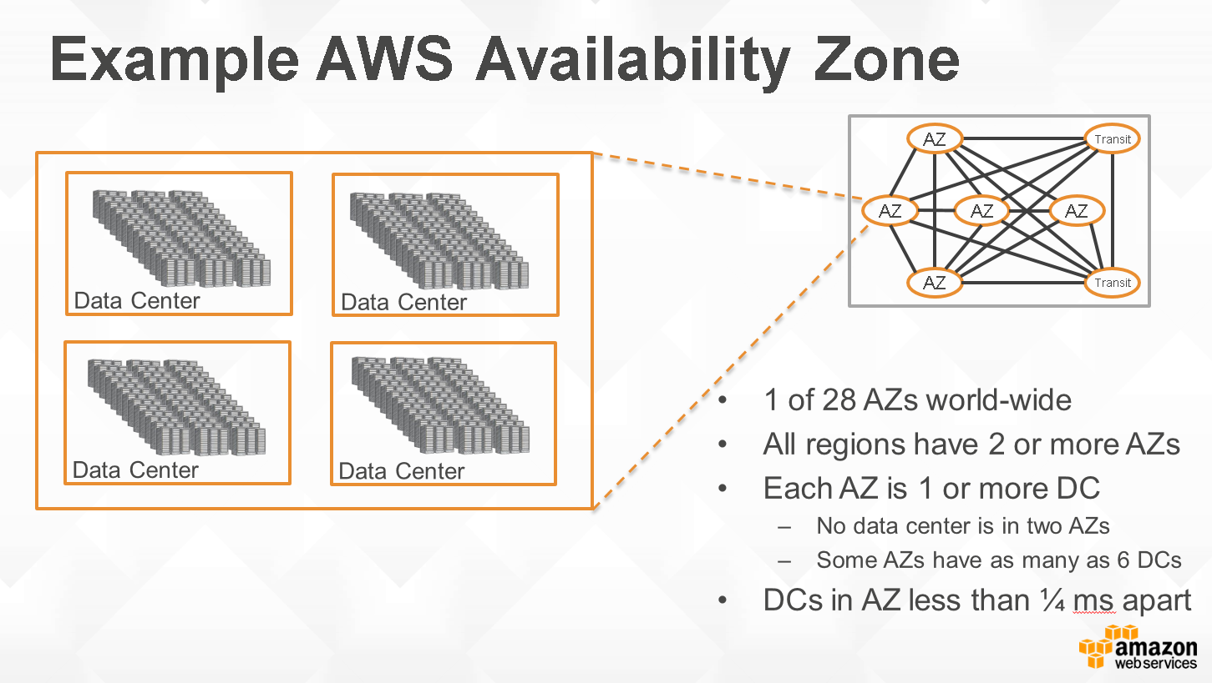

Slide 10
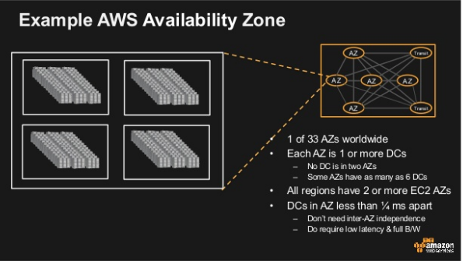

Slide 11
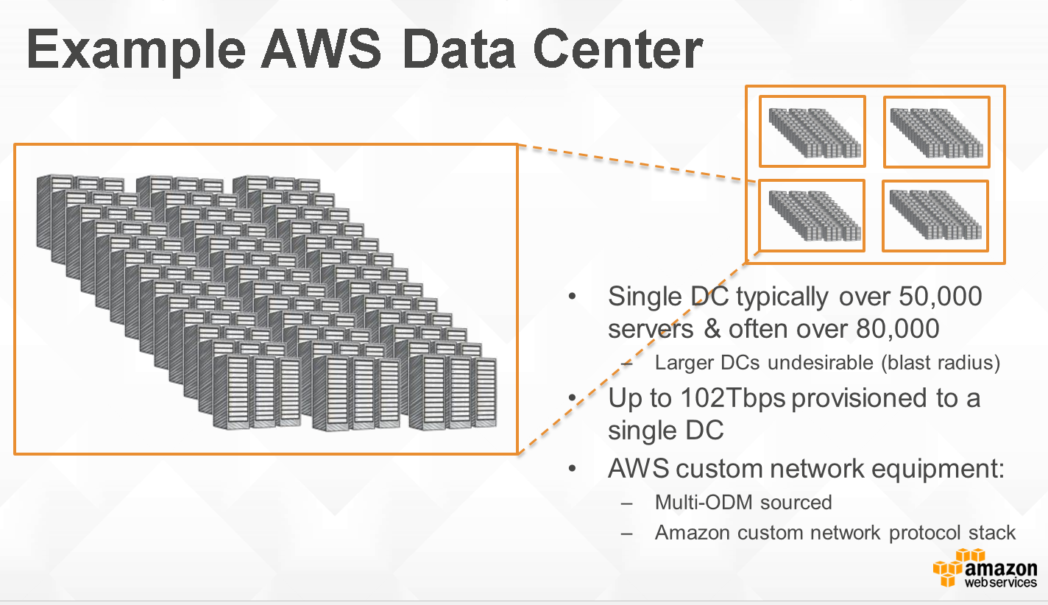

Slide 12
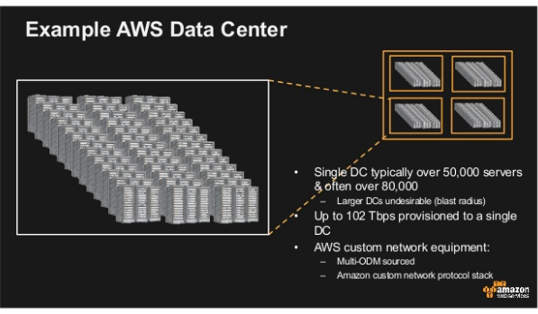

Slide 13
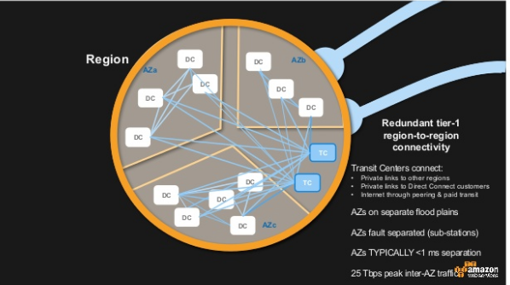

Slide 14
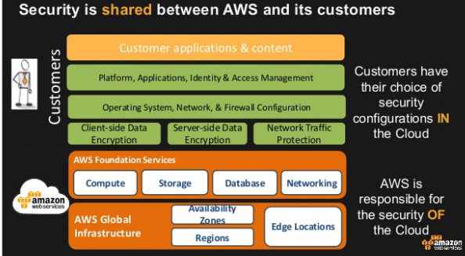

Slide 15
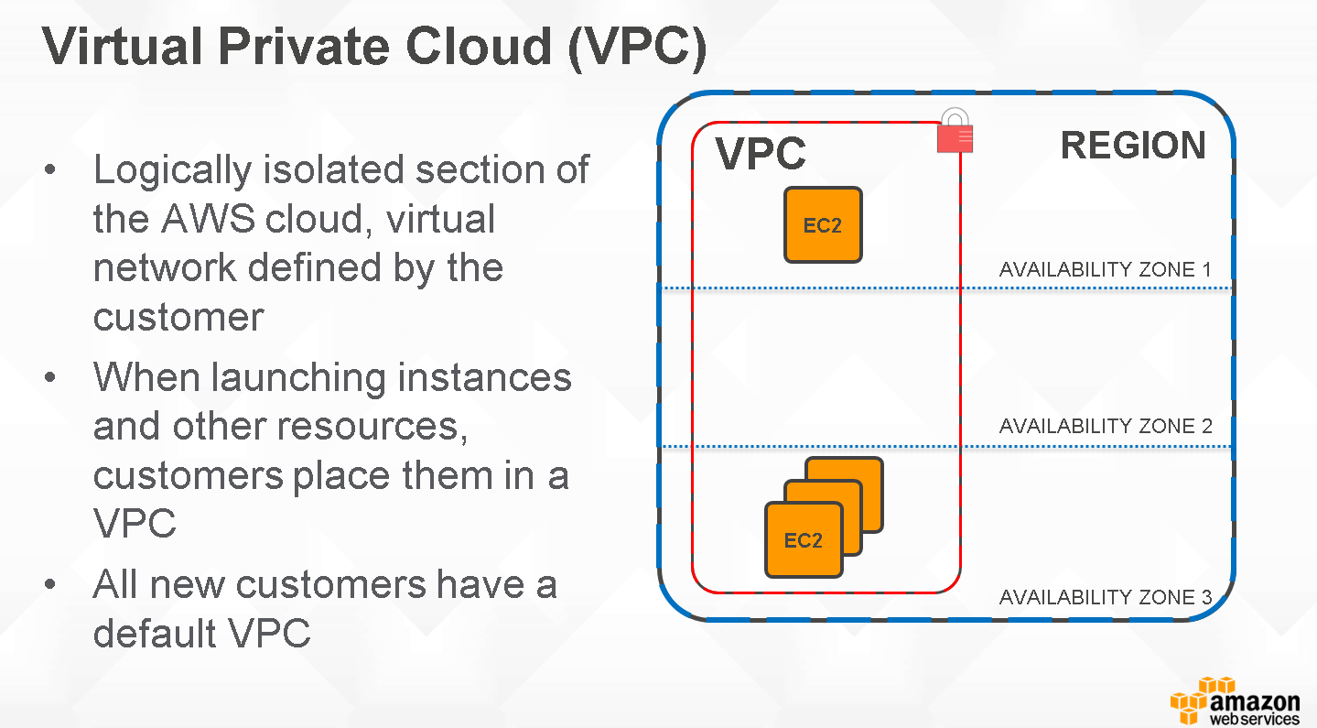

Slide 16
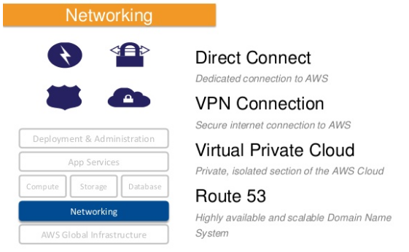

Slide 17
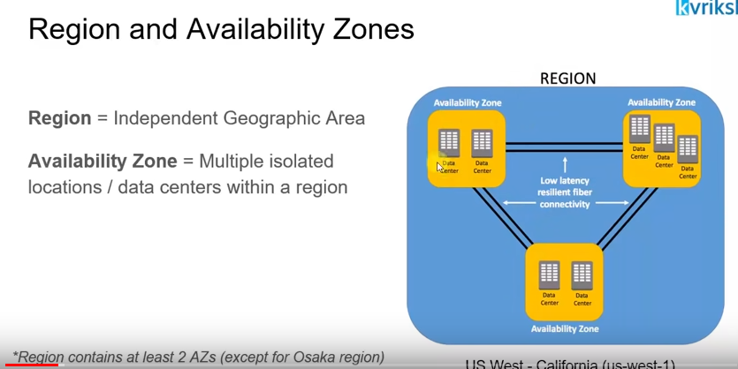
Region and Availability Zones

Slide 18
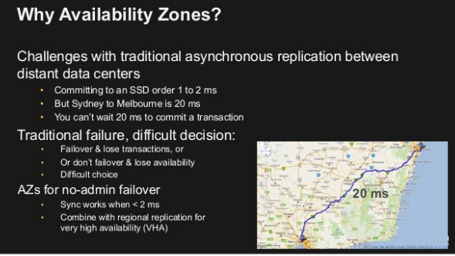

Slide 19
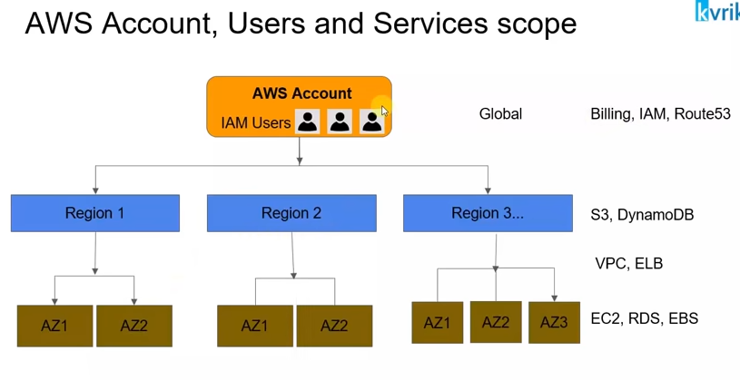
AWS Account, Users and Service scope

Slide 20
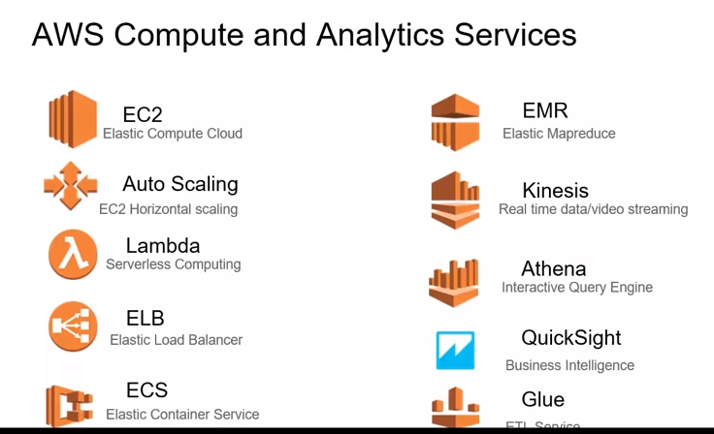
AWS Compute and Analytics Services

Slide 21
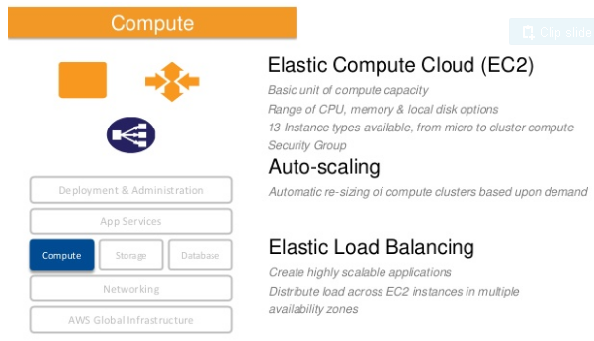

Slide 22
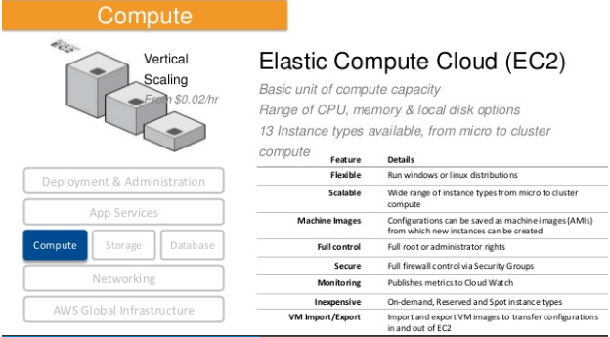

Slide 23
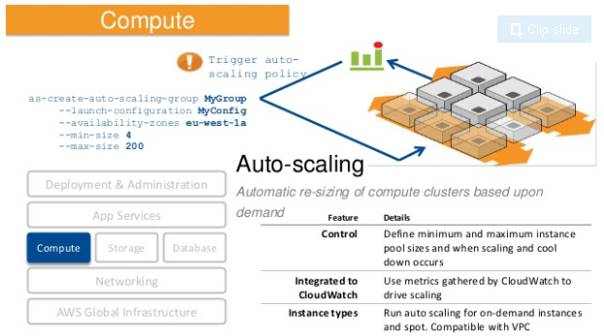

Slide 24
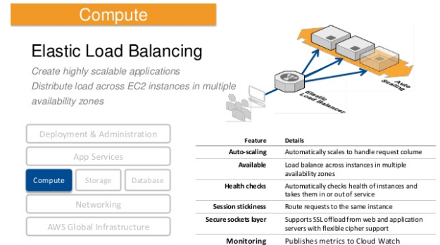

Slide 25
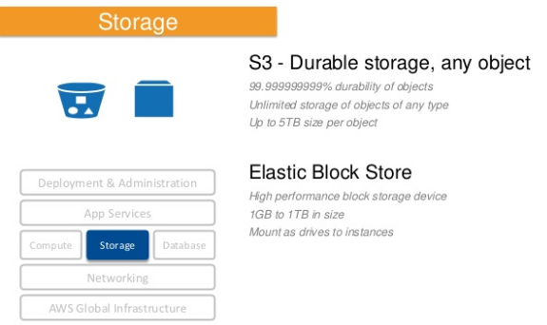

Slide 26
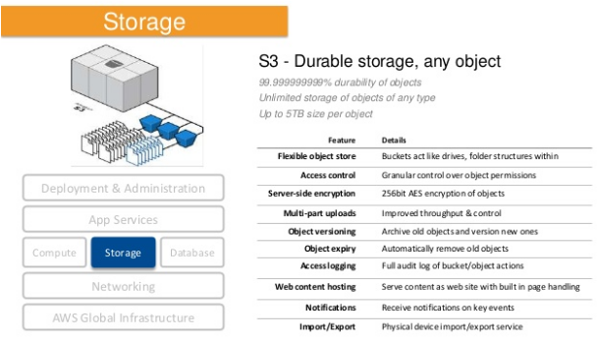

Slide 27
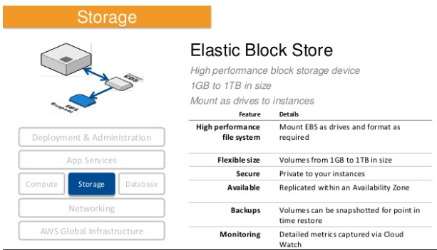

Slide 28
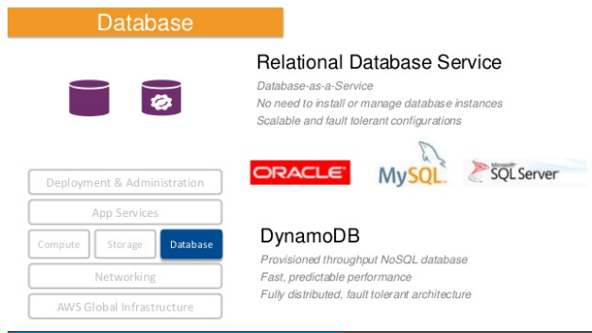

Slide 29
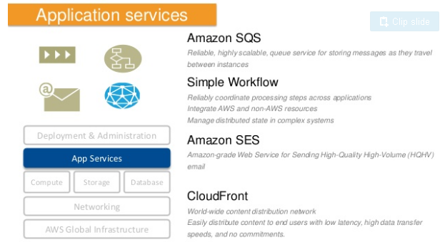

Slide 30
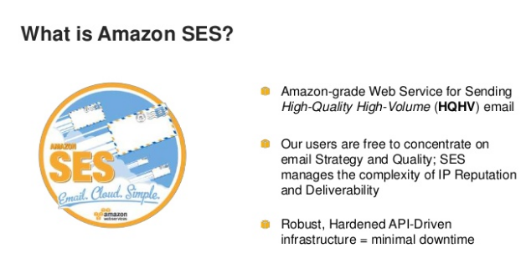
What is Amazon SES ?

Slide 31
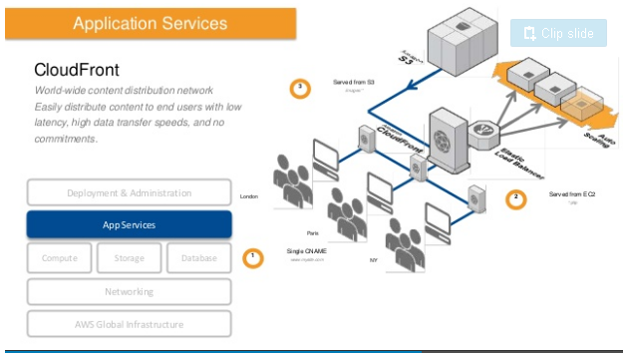

Slide 32
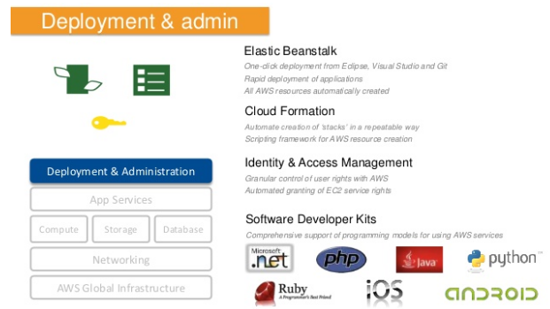

Slide 33
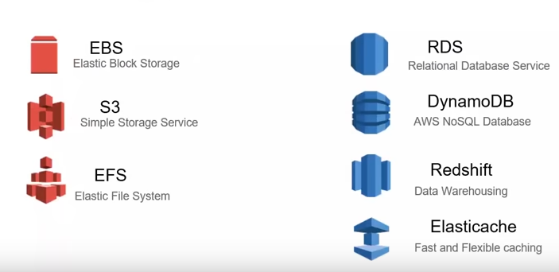
AWS Storage and Database Services

Slide 34
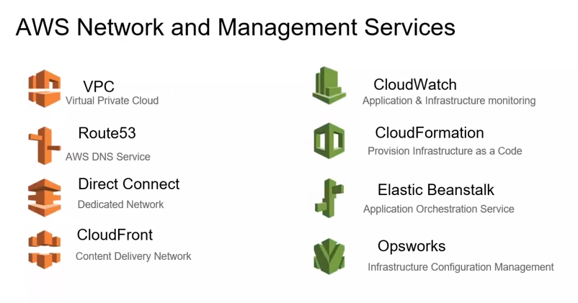
AWS Network and Management Services

Slide 35
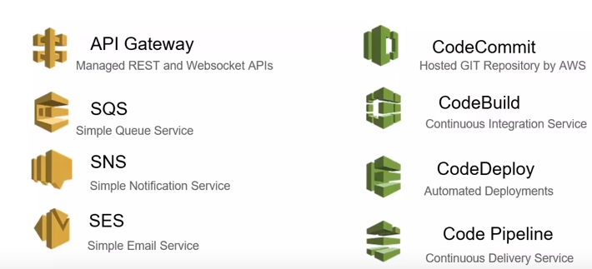
AWS Application and Development Services

Slide 36
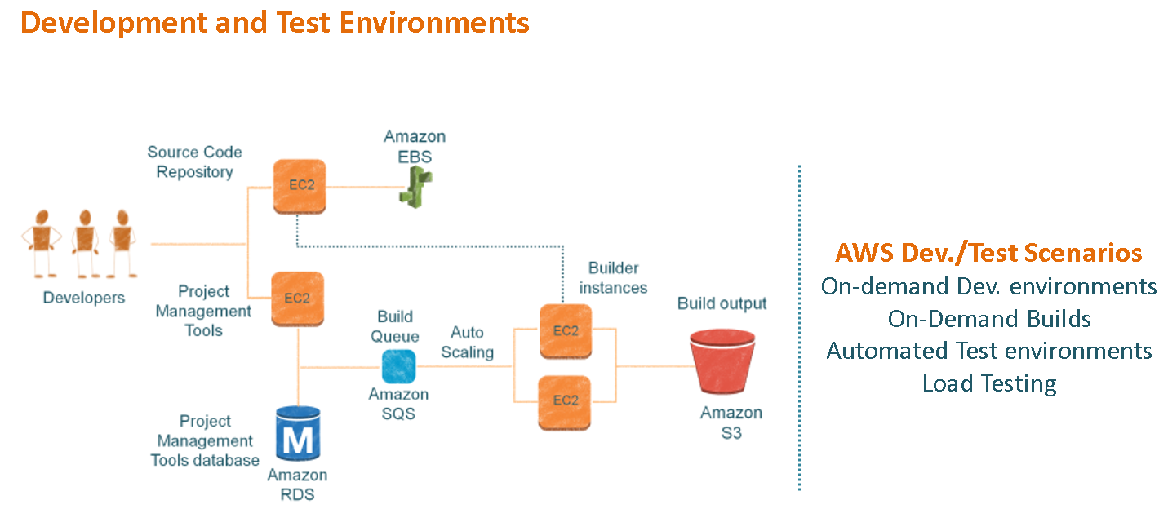

Slide 37
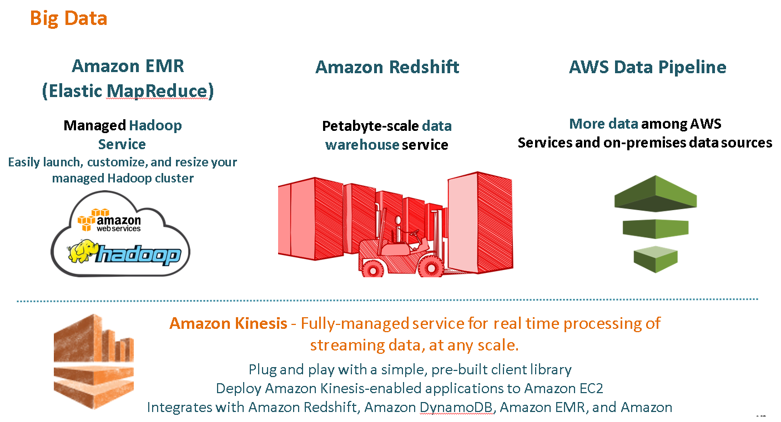

Slide 38
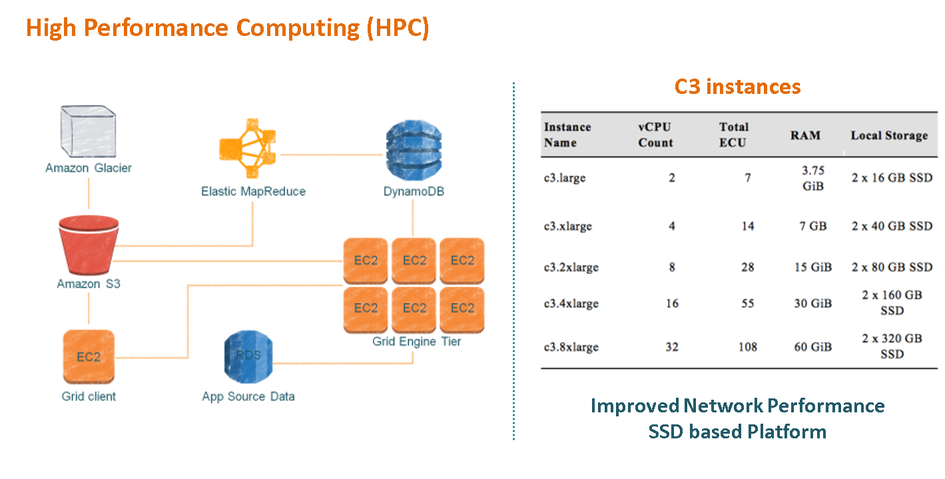

Slide 39
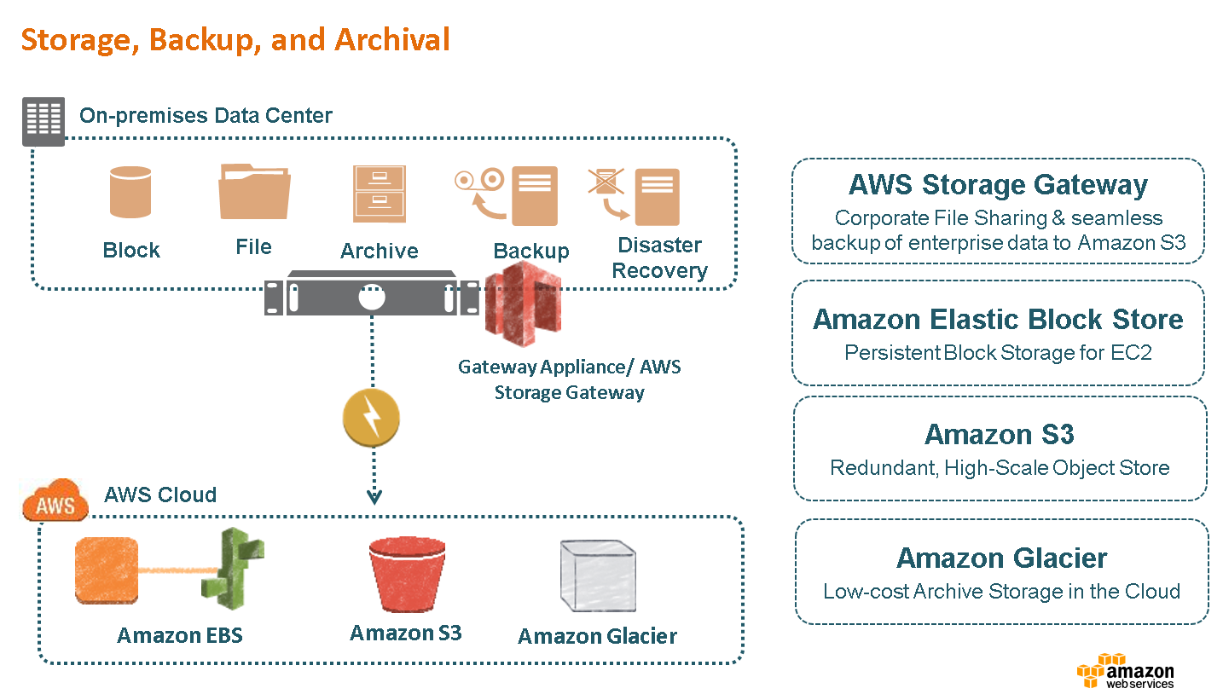

Slide 40
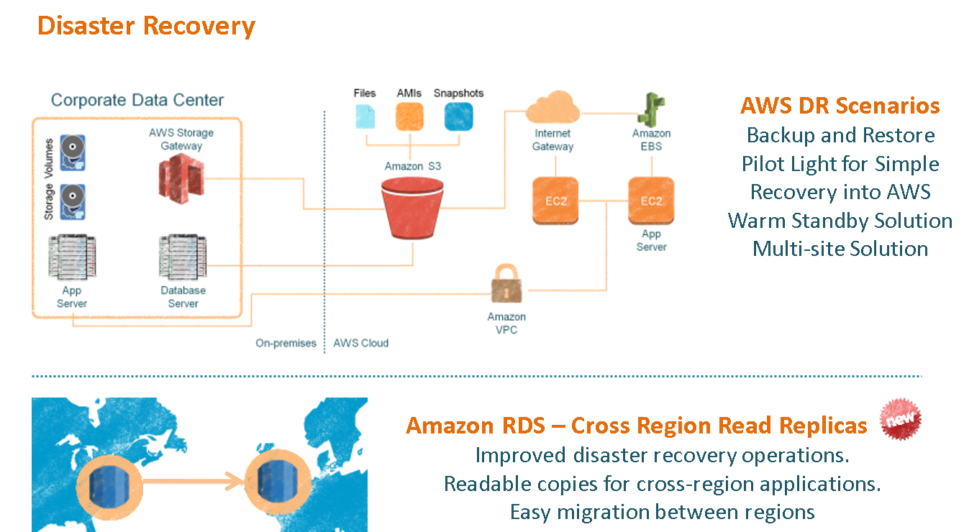

Slide 41
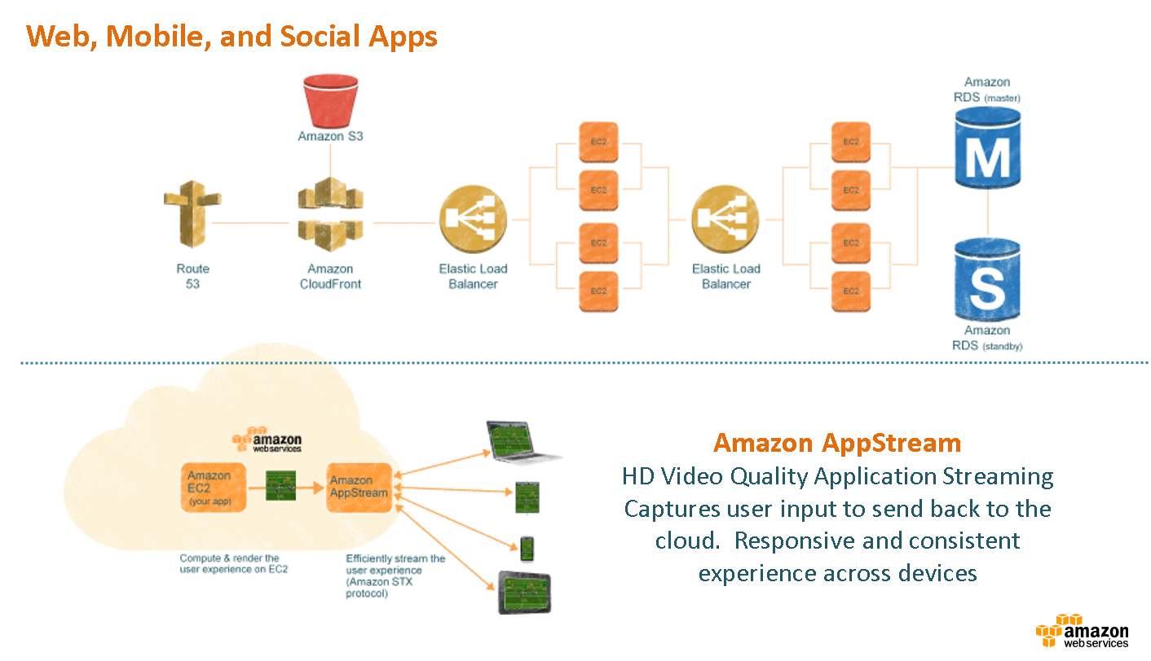

Slide 42
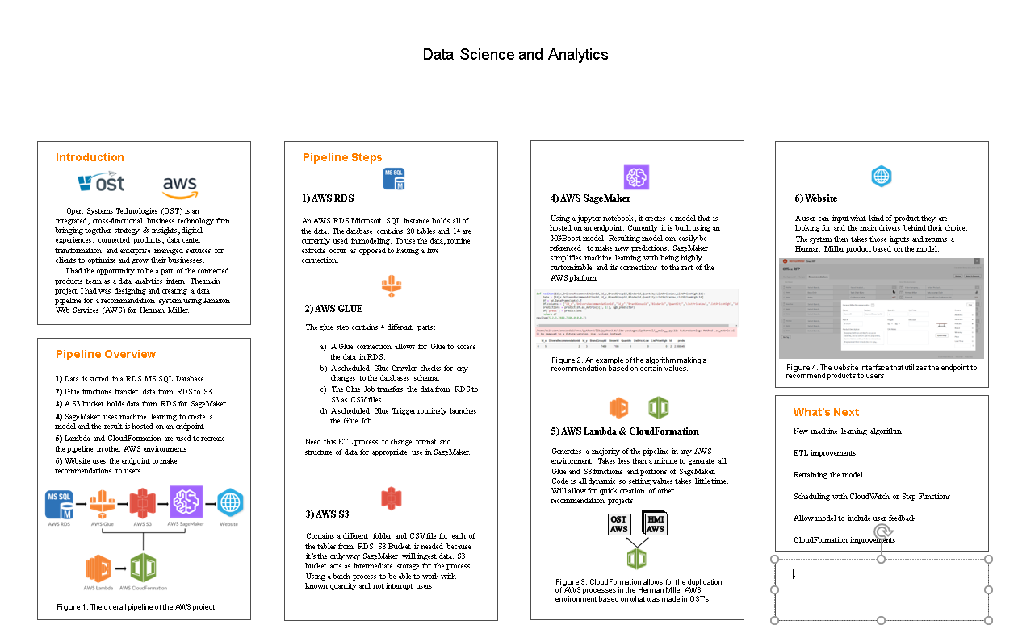

Slide 43
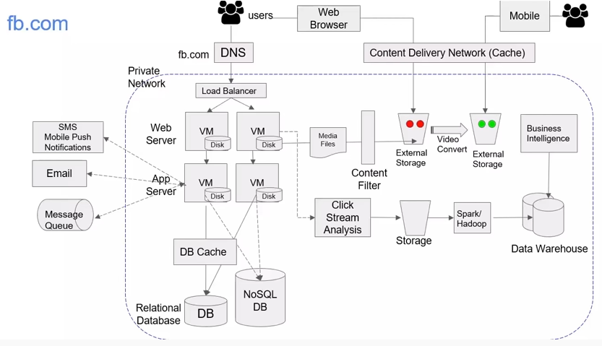

Slide 44
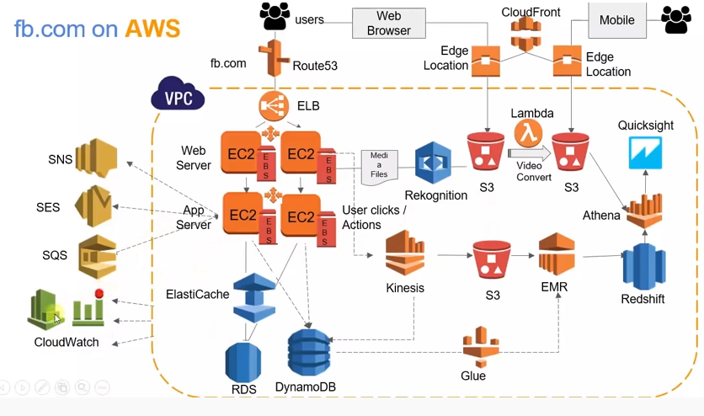

Slide 45

BIGDATA
Big Data
Dr Rajiv Misra

Slide 46
Content
Introduction
What is Big Data
Characteristic of Big Data
Storing,selecting and processing of Big Data
Why Big Data
How it is Different
Big Data sources
Tools used in Big Data
Application of Big Data
Risks of Big Data
Benefits of Big Data
How Big Data Impact on IT
Future of Big Data

Slide 47
Introduction
The first organizations to embrace it were online and startup firms. Firms like Google, eBay, LinkedIn, and Facebook were built around big data from the beginning.
Like many new information technologies, big data can bring about dramatic cost reductions, substantial improvements in the time required to perform a computing task, or new product and service offerings.

Slide 48
What is BIG DATA?
‘Big Data’ is similar to ‘small data’, but bigger in size, fast in velocity and of different types
but having data bigger it requires different approaches:
– Techniques, tools and architecture
an aim to solve new problems or old problems in a
better way
Big Data generates value from the storage and processing of very large quantities of digital information that cannot be analyzed with traditional computing techniques.

Slide 49
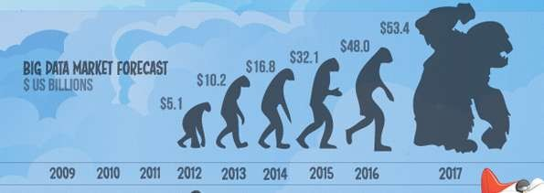
What is BIG DATA
Walmart handles more than 1 million customer transactions every hour.
Facebook handles 40 billion photos from its user base.
Decoding the human genome originally took 10years to process; now it can be achieved in one week.

Slide 50
Three Characteristics of Big Data V3s
Volume
Data quantity
Velocity
Data Speed
Variety
Data Types

Slide 51
1st Character of Big Data
Volume
A typical PC might have had 10 gigabytes of storage in 2000.
Today, Facebook ingests 500 terabytes of new data every day.
Boeing 737 will generate 240 terabytes of flight data during a single flight across the US.
The smart phones, the data they create and consume; sensors embedded into everyday objects will soon result in billions of new, constantly-updated data feeds containing environmental, location, and other information, including video.

Slide 52
2nd Character of Big Data Velocity
Clickstreams and ad impressions capture user behavior at millions of events per second
high-frequency stock trading algorithms reflect market changes within microseconds
machine to machine processes exchange data between billions of devices
infrastructure and sensors generate massive log data in real- time
on-line gaming systems support millions of concurrent users, each producing multiple inputs per second.

Slide 53
3rd Character of Big Data Variety
Big Data isn't just numbers, dates, and strings. Big Data is also geospatial data, 3D data, audio and video, and unstructured text, including log files and social media.
Traditional database systems were designed to address smaller volumes of structured data, fewer updates or a predictable, consistent data structure.
Big Data analysis includes different types of data

Slide 54
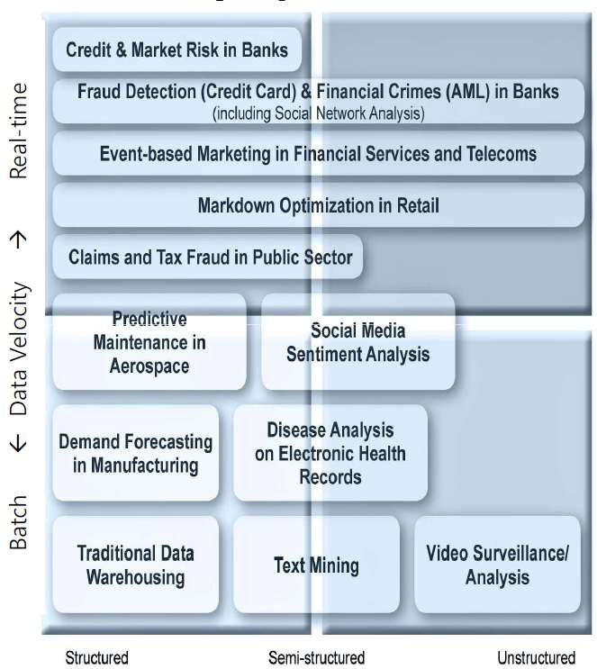
The Structure of Big Data
Structured
Most traditional data sources
Semi-structured
Many sources of big data
Unstructured
Video data, audio data
13

Slide 55
Why Big Data
Growth of Big Data is needed
Increase of storage capacities
Increase of processing power
Availability of data(different data types)
Every day we create 2.5 quintillion bytes of data; 90% of the data in the world today has been created in the last two years alone

Slide 56
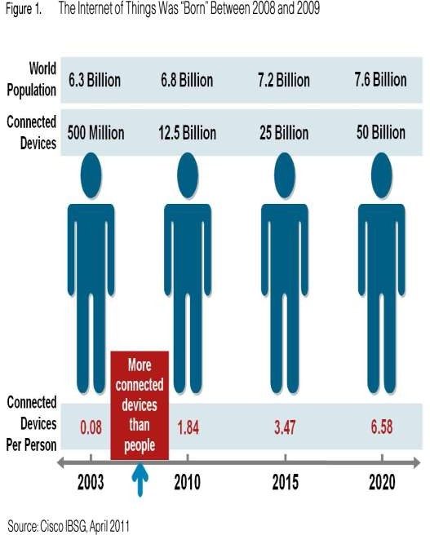
Why Big Data
FB generates 10TB daily
Twitter generates 7TB of data
Daily
IBM claims 90% of today’s stored data was generated in just the last two years.

Slide 57

How Is Big Data Different?
Automatically generated by a machine (e.g. Sensor embedded in an engine)
Typically an entirely new source of data (e.g. Use of the internet)
Not designed to be friendly (e.g. Text streams)
May not have much values
Need to focus on the important part
16

Slide 58
Big Data sources
Users
Large and growing files (Big data files)
Application
Systems
Sensors

Slide 59
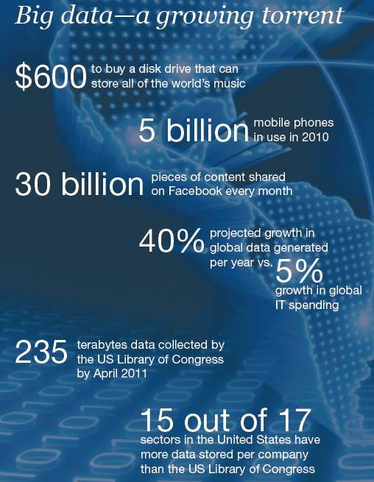
Data generation points Examples
Mobile Devices
Microphones Readers/Scanners Science facilities Programs/ Software Social Media Cameras

Slide 60
Big Data Analytics
Examining large amount of data
Appropriate information
Identification of hidden patterns, unknown correlations
Competitive advantage
Better business decisions: strategic and operational
Effective marketing, customer satisfaction, increased
revenue

Slide 61
Types of tools used in Big-Data
Where processing is hosted?
Distributed Servers / Cloud (e.g. Amazon EC2)
Where data is stored?
Distributed Storage (e.g. Amazon S3)
What is the programming model?
Distributed Processing (e.g. MapReduce)
How data is stored & indexed?
High-performance schema-free databases (e.g. MongoDB)
What operations are performed on data?
Analytic / Semantic Processing

Slide 62
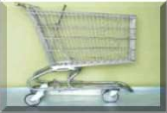





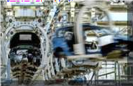

Application Of Big Data analytics
Smarter Healthcare
Multi-channel sales
Homeland Security
Telecom
Traffic Control
Trading
Analytics
Search
Quality
Manufacturing

Slide 63

Risks of Big Data
Will be so overwhelmed
Need the right people and solve the right problems
Costs escalate too fast
Isn’t necessary to capture 100%
Many sources of big data is privacy
self-regulation
Legal regulation
22

Slide 64
Storing Big Data
Analyzing your data characteristics
Selecting data sources for analysis
Eliminating redundant data
Establishing the role of NoSQL
Overview of Big Data stores
Data models: key value, graph, document, column-family
Hadoop Distributed File System
HBase
Hive

Slide 65
Processing Big Data
Integrating disparate data stores
Mapping data to the programming framework
Connecting and extracting data from storage
Transforming data for processing
Subdividing data in preparation for Hadoop MapReduce
Employing Hadoop MapReduce
Creating the components of Hadoop MapReduce jobs
Distributing data processing across server farms
Executing Hadoop MapReduce jobs
Monitoring the progress of job flows

Slide 66
Benefits of Big Data
Real-time big data isn’t just a process for storing petabytes or exabytes of data in a data warehouse, It’s about the ability to make better decisions and take meaningful actions at the right time.
Fast forward to the present and technologies like Hadoop give you the scale and flexibility to store data before you know how you are going to process it.
Technologies such as MapReduce,Hive and Impala enable you to run queries without changing the data structures underneath.

Slide 67
Benefits of Big Data
Our newest research finds that organizations are using big data to target customer-centric outcomes, tap into internal data and build a better information ecosystem.
Big Data is already an important part of the $64 billion database and data analytics market
It offers commercial opportunities of a comparable scale to enterprise software in the late 1980s
And the Internet boom of the 1990s, and the social media explosion of today.

Slide 68
Future of Big Data
$15 billion on software firms only specializing in data management and analytics.
This industry on its own is worth more than $100 billion and growing at almost 10% a year which is roughly twice as fast as the software business as a whole.
In February 2012, the open source analyst firm Wikibon released the first market forecast for Big Data , listing $5.1B revenue in 2012 with growth to
$53.4B in 2017
The McKinsey Global Institute estimates that data volume is growing 40% per year, and will grow 44x between 2009 and 2020.

Slide 69
Thank You.

Slide 71


Machine Learning on AWS with Amazon SageMaker

Slide 72
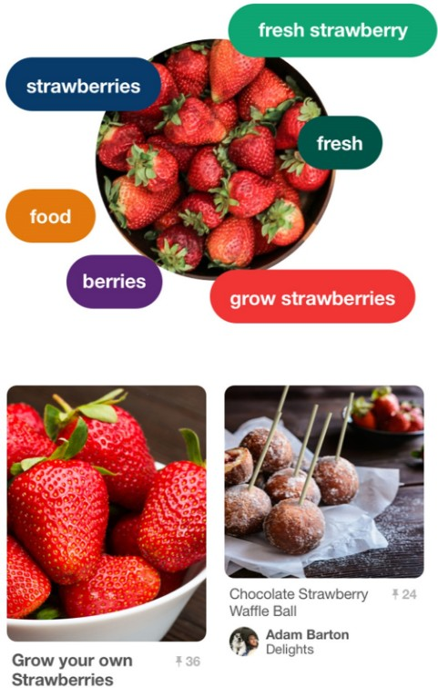

AWS Customers using AI
Pinterest Lens
Netflix Recommendation Engine

Slide 73
AWS ML Stack
Vision: Rekognition Image Rekognition Video
Speech: Polly Transcribe
Language:
Application Services
Lex Translate Comprehend
Platform Services
Amazon SageMaker
AWS
DeepLens
Amazon Machine Learning
Spark &
EMR
Mechanical
Turk
Gluon
Frameworks & Infrastructure _{GPU}
(P3 Instances)
AWS Deep Learning AMI
TensorFlow
Apache MXNet
Cognitive Toolkit
Caffe2 & Caffe
Keras
PyTorch
CPU
IoT
(Greengrass)
Mobile

Slide 74















ML Process
Business Problem –
ML problem framing
Re-training
Data Collection
Data Integration
Data Augmentation
Data Preparation & Cleaning
Feature Engineering
Monitoring & Debugging
Model Training & Parameter Tuning
Data Visualization & Analysis
– Predictions
Model Evaluation
Model Deployment
Feature Augmentation
No
Are Business Goals met?
Yes

Slide 75
ML Process: Discovery
Business Problem –
ML problem framing
Re-training
Data Collection
Data Integration
n
o
i
t
a t
_{me Data Preparation &} Feature Engineering ^{Monitoring &}
n
_{u Cleaning} Debugging
g
A
a
t
_{Da} Model Training &
Data Visualization & ^{Parameter Tuning – Predictions} Analysis
_{n} Model Evaluation _{Model Deployment}
o
i
t
a
t
n
e_{e}
r
tu^{m} _{a}g
^{FeAu No} Are Business ^{Yes} Goals met?
Ask the right questions
Domain Knowledge

Slide 76
ML Process: Integration – Data Architecture
Business Problem –
ML problem framing
Re-training
Data Collection
Data Integration
Build the Data Platform
Amazon S3
AWS Glue
Amazon Athena
Amazon EMR
Amazon Redshift
Amazon Kinesis
Data Augmentation
Data Preparation & Cleaning
Feature Engineering
Monitoring & Debugging
Model Training & Parameter Tuning
Data Visualization & Analysis
– Predictions
Model Evaluation
Model Deployment
Feature Augmentation
No
Are Business Goals met?
Yes

Slide 77




































Data Science Sandbox
Transactional Data
Amazon ElastiCache
Amazon Aurora
Amazon Athena
Relational Database Redis
Clusterless SQL Query
Amazon Redshift Data Warehouse
Amazon DynamoDB
NoSQL Database
Amazon S3 Data Lake
Amazon Glue Clusterless ETL
Visualization / Reporting
Data Sources
Any Open Source Tool of Choice on EC2
GPU Instances
Deep Learning
Amazon Kinesis Streams & Firehose
Amazon Machine Learning Predictive Analytics
Amazon EMR
Hadoop / Spark
AWS
Big Data Services
Amazon Elasticsearch Service
Amazon Kinesis Analytics
Apache Flink on EMR
Spark Streaming on EMR
Apache Storm on EMR
AWS Lambda

Slide 78
ML Process: Model Training
Business Problem –
Re-training
ML problem framing Data Collection
Setup and manage notebook environments
Setup and manage training clusters
Write data connectors
Scale ML algorithms to large datasets
Distribute ML training
algorithms to multiple machines
Secure and manage model artifacts
Data Integration
Data Augmentation
Data Preparation & Cleaning
Feature Engineering
Monitoring & Debugging
Model Training & Parameter Tuning
Data Visualization & Analysis
– Predictions
Model Evaluation
Model Deployment
Feature Augmentation
No
Are Business Goals met?
Yes

Slide 79
ML Process: Model Deployment
Business Problem –
ML problem framing
Re-training
Data Collection
Setup and manage model inference clusters
Manage and scale model inference APIs
Monitor and debug model predictions
Model versioning and
performance tracking
Automate new model
version promotion to production
(A/B testing)
Data Integration
Data Augmentation
Data Preparation & Cleaning
Feature Engineering
Monitoring & Debugging
– Predictions Model Deployment
Model Training & Parameter Tuning
Data Visualization & Analysis
Model Evaluation
Feature Augmentation
No
Are Business Goals met?
Yes

Slide 80

Amazon SageMaker
A fully managed service that enables data scientists and developers to quickly and easily build machine-learning based models into production smart applications.

Slide 81







Amazon SageMaker
Build
Pre-built notebook instances
Highly-optimized machine learning algorithms

Slide 82







Amazon SageMaker
Build
Pre-built notebook instances
Highly-optimized machine learning algorithms
Train
One-click training for ML, DL, and custom algorithms
Easier training with hyperparameter optimization

Slide 83



Amazon SageMaker
Build
Pre-built notebook instances
Fully-managed hosting at scale
Highly-optimized machine learning algorithms
Deploy
Train
Deployment without engineering effort
One-click training for ML, DL, and custom algorithms
Easier training with hyperparameter optimization

Slide 84


Amazon SageMaker
Build, train, and deploy machine learning models at scale
$
End-to-End Machine Learning Platform
Zero setup
Flexible Model Training
Pay by the second

Slide 85






Behind the scenes
Client application
Amazon SageMaker
Amazon ECR
Inference code
Training code
Model Training (on EC2)

Slide 86


Behind the scenes
Client application
Amazon SageMaker
Amazon ECR
Inference code
Training data
Training code
Helper code
Training code
Model Training (on EC2)

Slide 87

Behind the scenes
Client application
Amazon SageMaker
Amazon ECR
Model artifacts
Inference code
Training data
Training code
Helper code
Training code
Model Training (on EC2)

Slide 88


Behind the scenes
Client application
Amazon SageMaker
Amazon ECR
Model artifacts
Inference code Helper code
Model Hosting (on EC2)
Inference code
Training data
Training code
Helper code
Training code
Model Training (on EC2)

Slide 89

Behind the scenes
Client application
Inference response
Inference request _{Amazon SageMaker}
Amazon ECR
Inference Endpoint
Model artifacts
Inference code Helper code
Model Hosting (on EC2)
Inference code
Training data
Training code
Helper code
Training code
Model Training (on EC2)

Slide 90
Behind the scenes
Client application
Inference response
Inference request _{Amazon SageMaker}
Amazon ECR
Inference Endpoint
Ground Truth
Model artifacts
Inference code Helper code
Model Hosting (on EC2)
Inference code
Training data
Training code
Helper code
Training code
Model Training (on EC2)

Slide 91




Customer Example: Intuit
Near real-time fraud detection in AWS using Amazon SageMaker
Calculate Features
Feature Store
Model Training
(SageMaker)
Reader
Training
Amazon SageMaker
Data
Model
Cleanser
Lookup
Processor
Model Hosting
(SageMaker)
Amazon SageMaker
Client Service
Amazon EMR

Slide 92




Amazon SageMaker
1
2
3
4
I | I | I | I
Notebook Instances | Algorithms | ML Training Service | ML Hosting Service

Slide 93







Notebook Instances
1
Zero Setup For Exploratory Data Analysis
“Just add data”
Recommendations/Personalization
Fraud Detection
Forecasting
Image Classification
Churn Prediction
Marketing Email/Campaign Targeting
Log processing and anomaly detection
Speech to Text
More…
Authoring Notebooks
Access to S3 Data Lake
ETL Access to AWS Database services

Slide 94




Algorithms
2
Amazon SageMaker: 10x better algorithms
Streaming datasets, for cheaper training
Train faster, in a single pass
Greater reliability on extremely large datasets
Choice of several ML algorithms

Slide 95

Linear Learner
Find linear equation that best approximates the data
Supervised
Supports:
Binary classification
Multiclass classification
Linear regression
Floating-point or test
CSV or recordIO-protobuf
Parallel training of multiple models with automatic hyperparameter optimization

Slide 96
Linear Learner
Regression (mean squared error)
SageMaker | Other
1.02 | 1.06
1.09 | 1.02
0.332 | 0.183
0.086 | 0.129
83.3 | 84.5
30 GB datasets for web-spam and web-url classification
1,2
1
0,8
0,6
0,4
0,2
0
Cost in Dollars
Classification (F1 Score)
SageMaker | Other
0.980 | 0.981
0.870 | 0.930
0.997 | 0.997
0.978 | 0.964
0.914 | 0.859
0.470 | 0.472
0.903 | 0.908
0.508 | 0.508
0
5
10
15
Billable time in Minutes
20
25
30
sagemaker-url
sagemaker-spam other-url
other-spam

Slide 97

Factorization Machines
Extends linear model to pair-wise interactions between features
Good for high dimensional sparse datasets, e.g.:
Click prediction
Item recommendation systems
Supports binary classification or linear regression
recordIO-protobuf data format

Slide 98

Factorization Machines
 | Log_loss | F1 Score | Seconds
SageMaker | 0.494 | 0.277 | 820
Other (10 Iter) | 0.516 | 0.190 | 650
Other (20 Iter) | 0.507 | 0.254 | 1300
Other (50 Iter) | 0.481 | 0.313 | 3250
Click Prediction 1 TB advertising dataset, m4.4xlarge machines, perfect scaling.
$200,00
$180,00
$160,00
$140,00
$120,00
$100,00
$80,00
$60,00
$40,00
$20,00
$-
Cost in Dollars
50 0 30 20
machines machines
10
machines
4
1
2
3
4 5
Billable Time in Hours
6
7
8

Slide 99

K-Means Clustering
Cluster data into k groups
Unsupervised
Algorithm:
Start with K= k*x cluster centers
Iterate over cluster centers in mini- batches and adjust them based on training data
Reduce K cluster centers to k final clusters by using the same algorithm.
Image: johnloeber.com
Used under CC BY-NC-SA 4.0

Slide 100
K-Means Clustering
 | k | SageMaker | Other
Text 1.2GB | 10 | 1.18E3 | 1.18E3
 | 100 | 1.00E3 | 9.77E2
 | 500 | 9.18.E2 | 9.03E2
Images 9GB | 10 | 3.29E2 | 3.28E2
 | 100 | 2.72E2 | 2.71E2
 | 500 | 2.17E2 | Failed
Videos 27GB | 10 | 2.19E2 | 2.18E2
 | 100 | 2.03E2 | 2.02E2
 | 500 | 1.86E2 | 1.85E2
Advertising 127GB | 10 | 1.72E7 | Failed
 | 100 | 1.30E7 | Failed
 | 500 | 1.03E7 | Failed
Synthetic 1100GB | 10 | 3.81E7 | Failed
 | 100 | 3.51E7 | Failed
 | 500 | 2.81E7 | Failed
Running Time vs. Number of Clusters
8
7
6
5
4
Billable Time in Minutes
3
~10x Faster!
2
1
0
10
100
Number of Clusters
500
sagemaker
other

Slide 101

Principal Component Analysis (PCA)
Reduce dimensionality while retaining as much information as possible
Finds new components, sorted by information value.
Unsupervised
Regular (for sparse) and Randomized (for large, dense datasets) modes
Image: Wikimedia Commons

Slide 102

Principal Component Analysis (PCA)
Cost vs. Time
Throughput and Scalability
5
4,5
4
3,5
3
2,5
2
1,5
1
0,5
0
 |  | More th | an 10x fa | ster
 |  | at a fract | ion the | cost!
120,00
100,00
Mb/Sec/Machine
80,00
Cost in Dollars
60,00
40,00
20,00
0,00
10
Number of Machines
8
20
0
10
20 30
Billable time in Minutes
sagemaker-deterministic
40 50
sagemaker-randomized
other
other
sagemaker-deterministic
sagemaker-randomized

Slide 103
Neural Topic Modeling
Perplexity vs. Number of Topic (~200K documents, ~100K vocabulary)
Output term counts vector
12000
Decoder: Softmax
Sampled Document Representation
10000
8000
Document Posterior
Perplexity
6000
4000
Encoder: feedforward net
2000
0
100
Number of Topics
NTM Other
0
50
150
200
Input term counts vector

Slide 104


Spectral Latent Dirichlet Allocation (LDA)
Training Time vs. Number of Topics
250
200
150
100
50
0
Training Time in Minutes
0
20
40 60
Number of Topics
lda-data-b other-data-a
80
100
lda-data-a
other-data-b

Slide 105



Boosted Decision Trees
XGBoost gradient boosted trees algorithm
Combines multiple weak decision tree models
Supervised
Binary and multiclass classification
Libsvm or CSV data
Image:Arxiv.org

Slide 106

Boosted Decision Trees
XGBoost is one of the most commonly used implementations of boosted decision trees in the world.
Throughput vs. Number of Machines
1400
1200
Throughput in MB/Sec
1000
It is now available in Amazon SageMaker!
800
600
400
200
0
0
10
20 30 40 50
Number of Machines (C4.8xLarge)
60
70

Slide 107

Sequence to Sequence
Based on Sockeye Seq2Seq implementation
Encoder, Attention, Decoder architecture
See: https://aws.amazon.com/blogs/ai/train-neural-machine-translation-models-with-sockeye/

Slide 108

Sequence to Sequence
Based on Sockeye and Apache incubated MxNet, Multi-GPU, and can be used for Neural Machine Translation.
English-German Translation
25
20
BLEU Score
15
Supports both RNN/CNN as encoder/decoder
Best
ult!
10
known res
5
0
0
5
10 15
Billable Time in Hours
P2.16x P2.8x
20
25
P2.x

Slide 109

Image Classification
Build your own “Rekognition” service!
Currently based on ResNet
Configurable number of layers
Full training and transfer learning
Data formats:
Apache MXNet RecordIO
.jpg or .png

Slide 110
Image Classification
Speedup with Horizontal Scaling
Implementation in MxNet of ResNet.
Other networks such as DenseNet and Inception will be added in the future.
3,5
3
2,5
Speedup
2
Transfer learning: begin with a model already trained on ImageNet!
1,5
1
0,5
0
2 3
Number of Machine (P2)
0
1
4
5

Slide 111


Your Own Algorithms
Bring your own algorithm!
Just wrap it into a Docker container
One container for training
One container for inference
Combine SageMaker containers with your own
Documented example on GitHub

Slide 112

Deep Neural Networks
Train your own
Deep Neural Networks!
TensorFlow and Apache MXNet supported
You provide training/inference scripts with your DNN
SageMaker does the rest

Slide 113

Using SageMaker with Apache Spark
Apache Spark library for Amazon SageMaker provided
Both Python and Scala
Makes org.apache.spark.sql.DataFrame objects available to SageMaker
Training and Inference supported

Slide 114





Algorithms
2
Amazon SageMaker: 10x better algorithms
Training code
•
•
•
•
•
•
Matrix Factorization Regression
Principal Component Analysis K-Means Clustering
Gradient Boosted Trees And More!
Bring Your Own Script (SageMaker builds the Container)
SageMakerEstimators in Apache Spark
Amazon provided Algorithms
Bring Your Own Algorithm (You build the Container)

Slide 115





ML Training Service
3
–
Secured
Save Model Artifacts
Fetch Training
Training code
Save Inference Image
•
•
•
•
•
•
Matrix Factorization Regression
Principal Component Analysis K-Means Clustering
Gradient Boosted Trees And More!
Bring Your Own Script (SageMaker builds the Container)
SageMakerEstimators in Apache Spark
Amazon provided Algorithms
Bring Your Own Algorithm (You build the Container)
CPU GPU
HPO
Fully managed
–

Slide 116






Model Deployment
4
Versions of the same inference code saved in inference containers. Prod is the primary one, 50% of the traffic must be served there!
Amazon ECR
Amazon SageMaker

Slide 117
Model Deployment
4
Model Artifacts
Create a Model
ModelName: prod
Versions of the same inference code saved in inference containers. Prod is the primary one, 50% of the traffic must be served there!
Inference Image
Amazon ECR
Amazon SageMaker

Slide 118
Model Deployment
4
Model Artifacts
Create versions of a Model
Versions of the same inference code saved in inference containers. Prod is the primary one, 50% of the traffic must be served there!
Inference Image
Model versions
Amazon ECR
Amazon SageMaker

Slide 119
Model Deployment
4
Model Artifacts
InstanceType: c3.4xlarge
InitialInstanceCount: 3 ModelName: prod VariantName: primary
30
50
InitialVariantWeight: 50
Versions of the same inference code saved in inference containers. Prod is the primary one, 50% of the traffic must be served there!
ProductionVariant
10
10
Create weighted ProductionVariants
Inference Image
Model versions
Amazon ECR
Amazon SageMaker

Slide 120
Model Deployment
4
Model Artifacts
Inference Endpoint
InstanceType: c3.4xlarge
InitialInstanceCount: 3 ModelName: prod VariantName: primary
30
50
InitialVariantWeight: 50
Versions of the same inference code saved in inference containers. Prod is the primary one, 50% of the traffic must be served there!
ProductionVariant
10
10
Create an Endpoint from one EndpointConfiguration
Inference Image
Model versions
EndpointConfiguration
Amazon ECR
Amazon SageMaker

Slide 121
Model Deployment
4
Model Artifacts
Inference Endpoint
InstanceType: c3.4xlarge
InitialInstanceCount: 3 ModelName: prod VariantName: primary
30
50
InitialVariantWeight: 50
Versions of the same inference code saved in inference containers. Prod is the primary one, 50% of the traffic must be served there!
ProductionVariant
One-Click!
10
10
Inference Image
Amazon Provided Algorithms
Model versions
EndpointConfiguration
Amazon ECR
Amazon SageMaker

Slide 122
Model Deployment
4
Auto-Scaling Inference APIs
A/B Testing (more to come)
Low Latency & High Throughput
Bring Your Own Model
Python SDK
Amazon SageMaker

